Slide 1
Network Threat Alert System
Audrey
Jan
Adrian
Gavriel
RJ

Slide 2



Project Background
Everyday Network Exploits:
Malware Botnets Zero-day Attacks

Slide 3
Purpose and Description
Detect and log malicious attacks
Avoid corruption and loss of data
Enhance operations

Slide 4
Objectives
General
Efficiently identify zero-day attacks
Specific
Provide a method to save new types of attacks
Analyze zero-day attacks
Use a Honeypot connected to SNORT to lure unsaved attacks
Use correlation to identify new and unsaved types of attacks

Slide 5


Scope and Limitations
Detection Monitoring

Slide 6
Technical Background (Software)
NTAS
SNORT
Honeybot
XAMPP

Slide 7



Technical Background (Recommended Hardware)

Slide 8
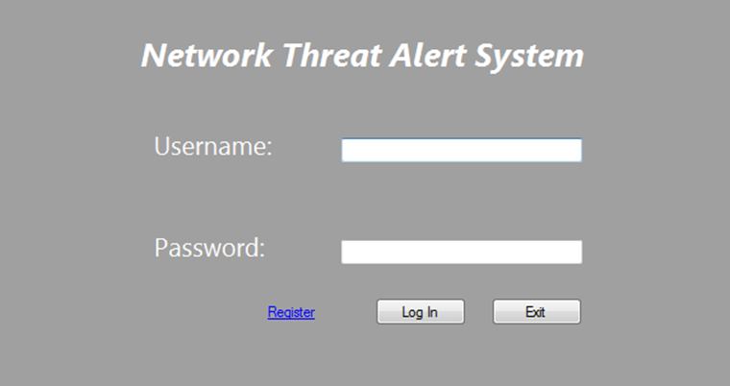
Design and Methodology

Slide 9
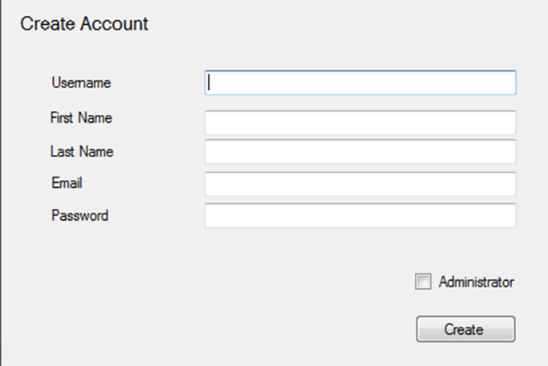
Design and Methodology

Slide 10
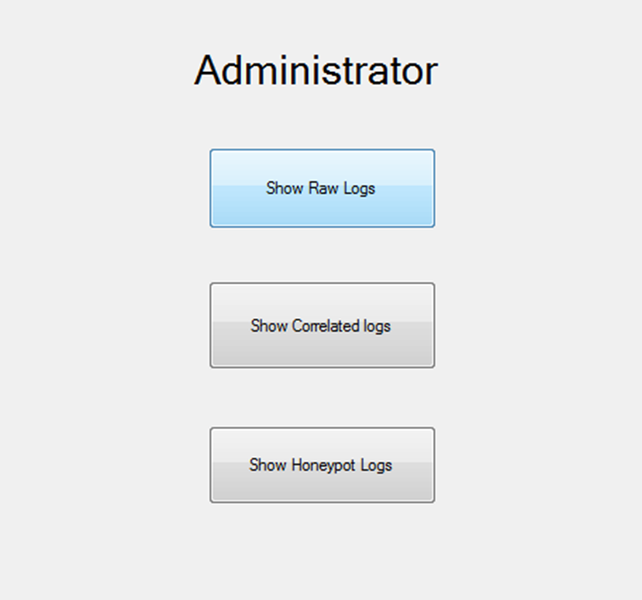
Design and Methodology

Slide 11
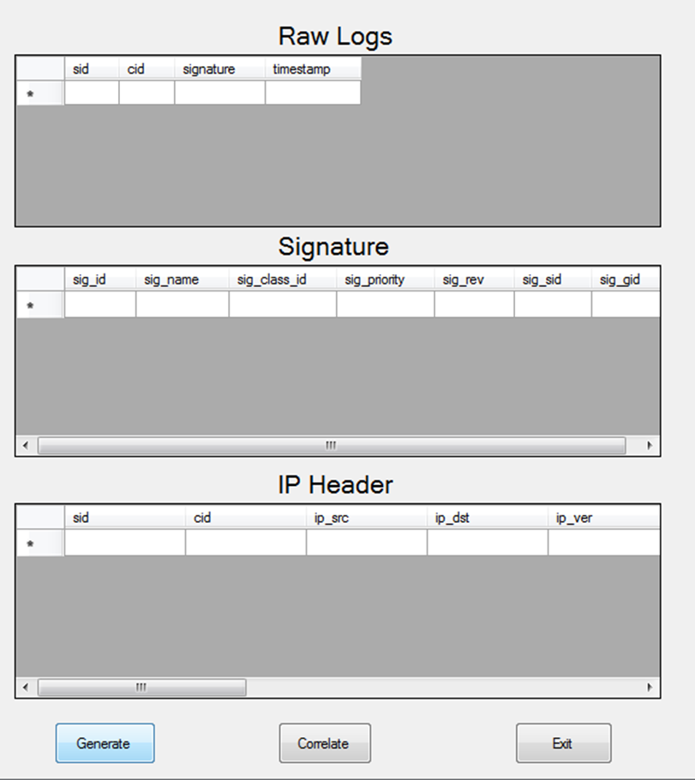
Design and Methodology

Slide 12
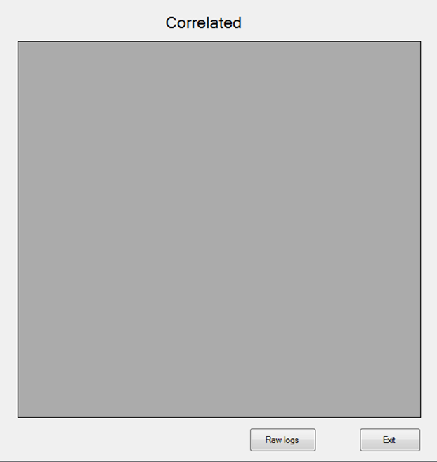
Design and Methodology

Slide 13
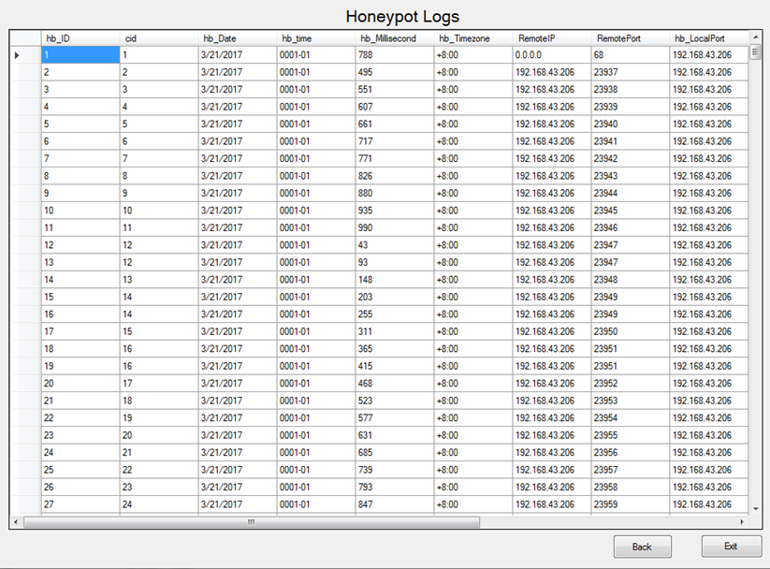
Design and Methodology

Slide 14
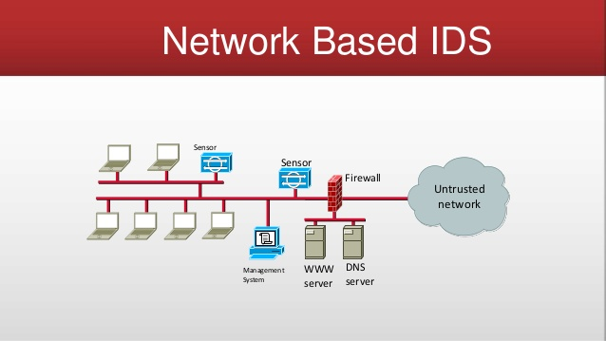
Related Literature
Detection of Attacks and Intrusion Detection Systems (IDS)

Slide 15

Related Literature
Automatic SNORT IDS rule generator based on Honeypot log

Slide 16
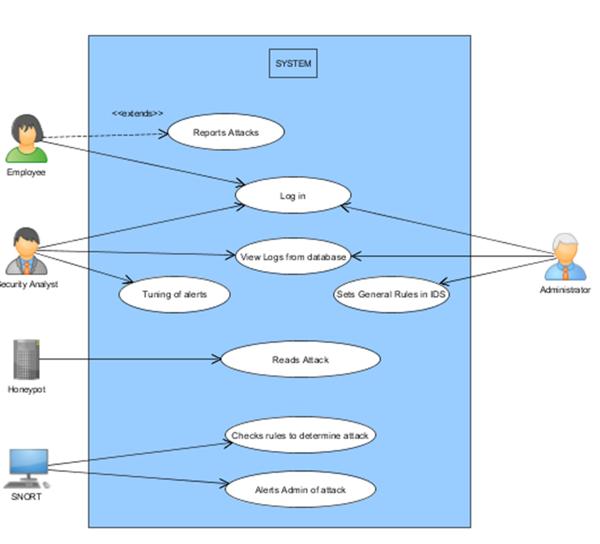
Use Case

Slide 17
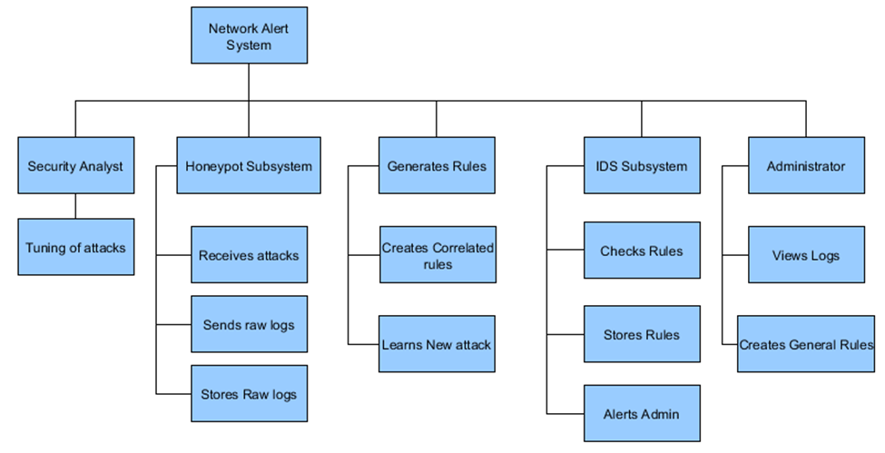
FDD

Slide 18
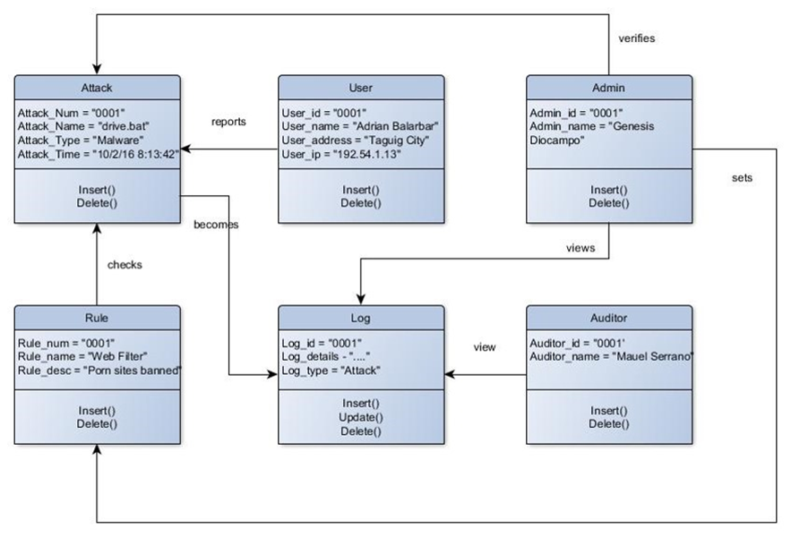
Object Diagram

Slide 19
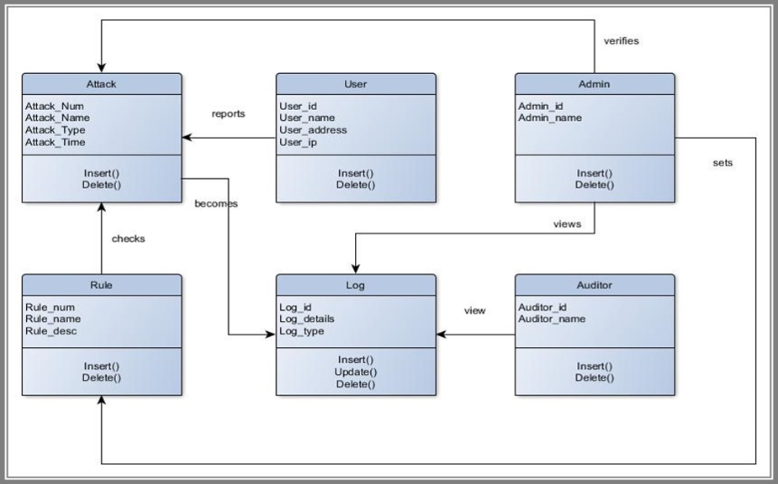
Class Diagram

Slide 20
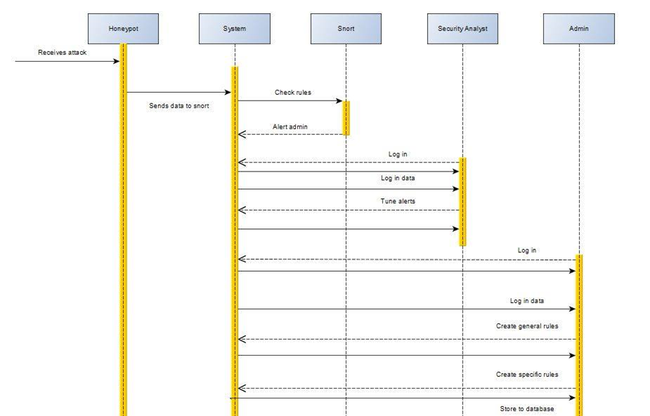
Sequence Diagram

Slide 21
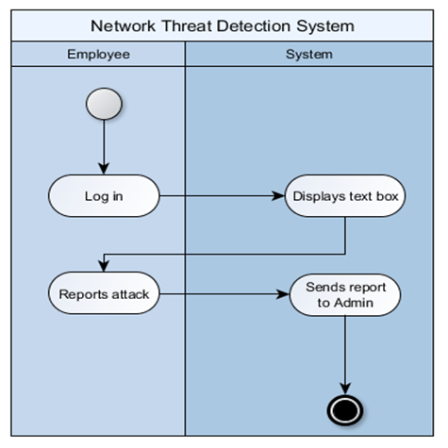
Activity Diagrams

Slide 22
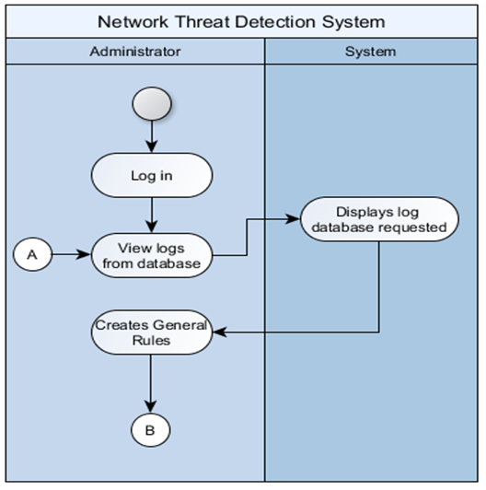
Activity Diagrams

Slide 23
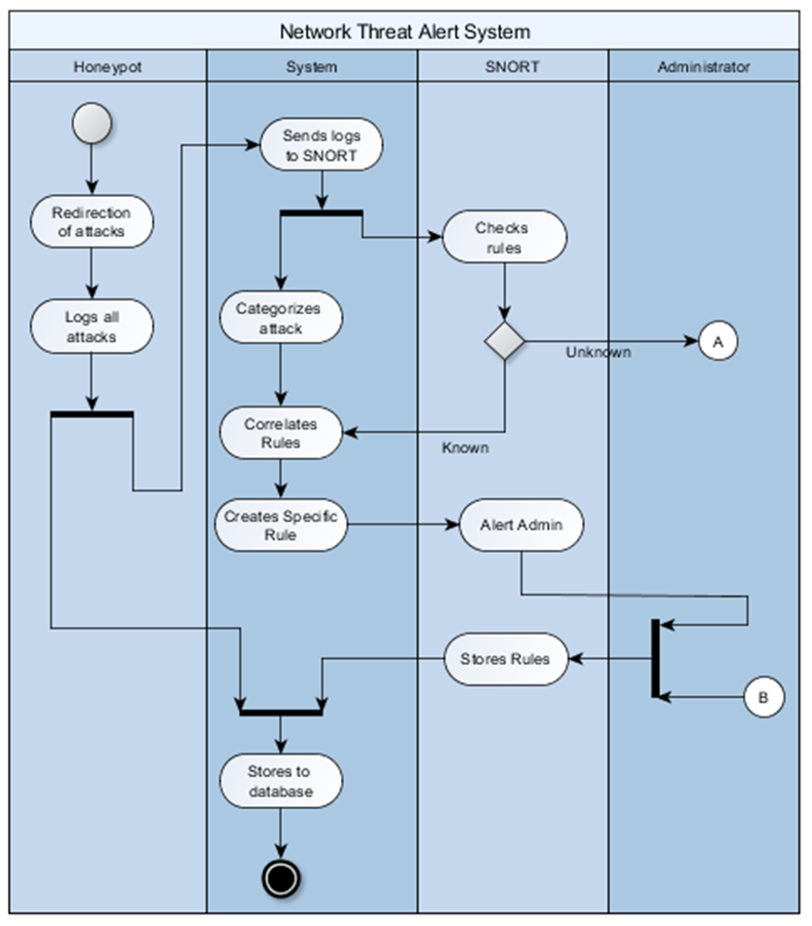
Activity Diagrams

Slide 24
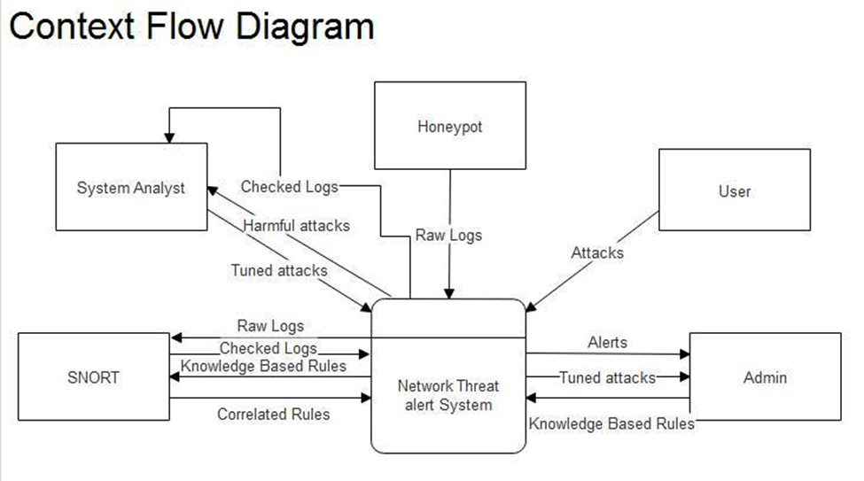

Slide 25
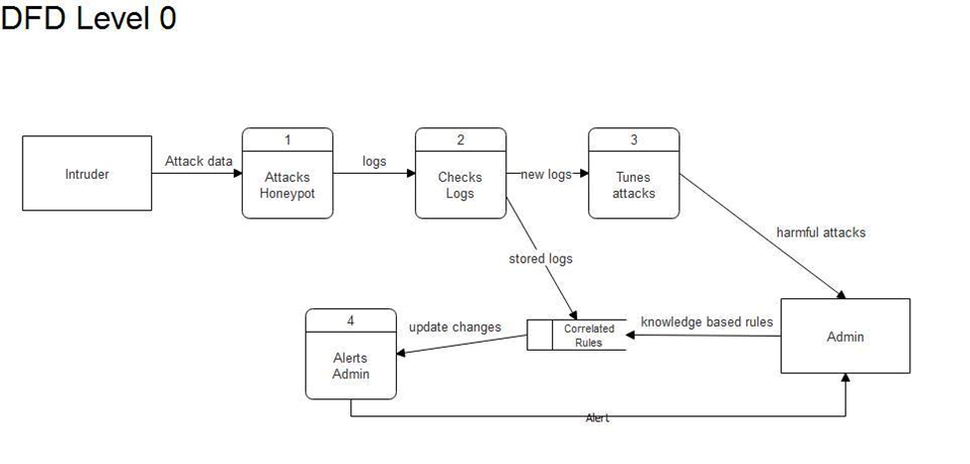

Slide 26
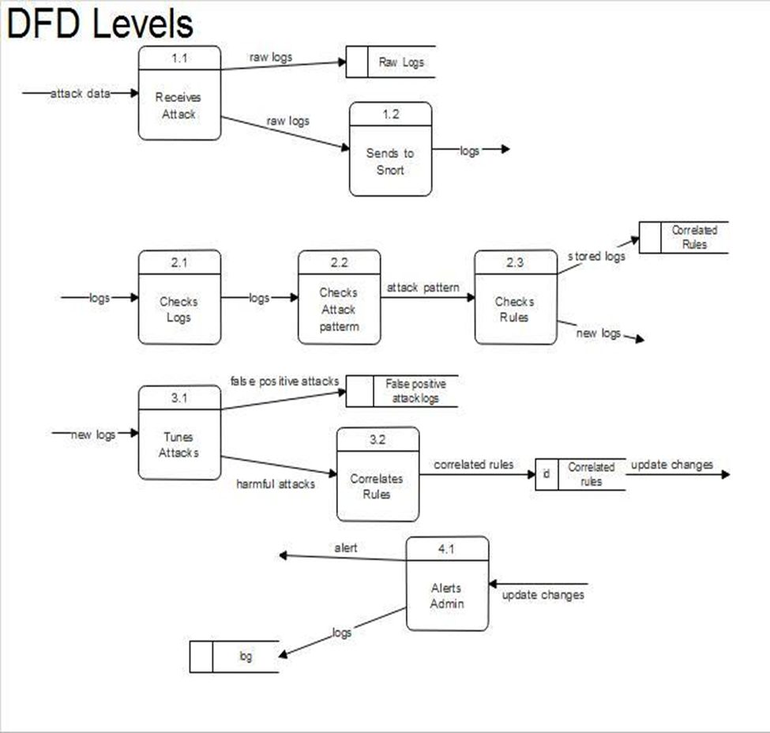

Slide 27
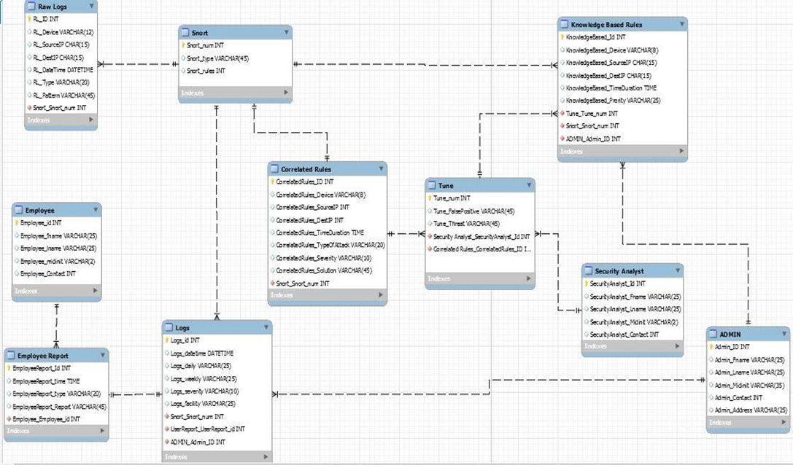
ERD

Slide 28
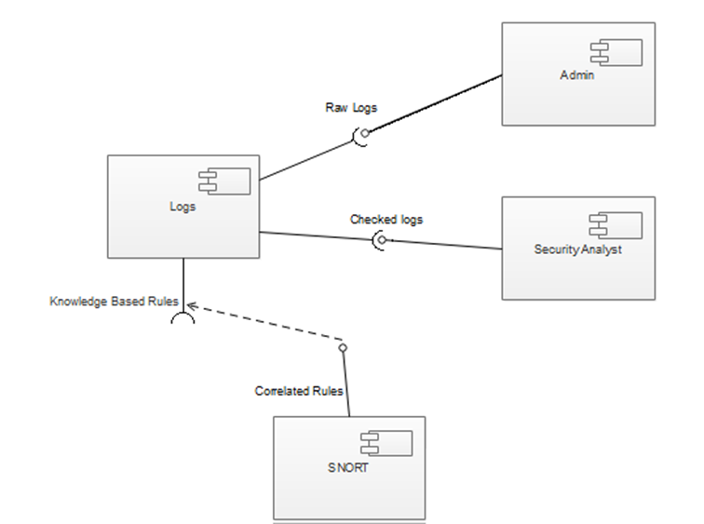
Component Diagram

Slide 29
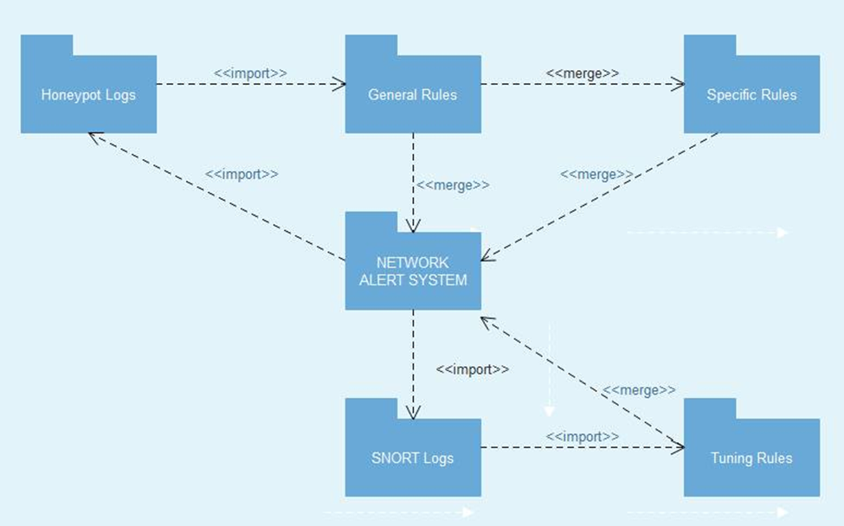
Packaging Diagram

Slide 30
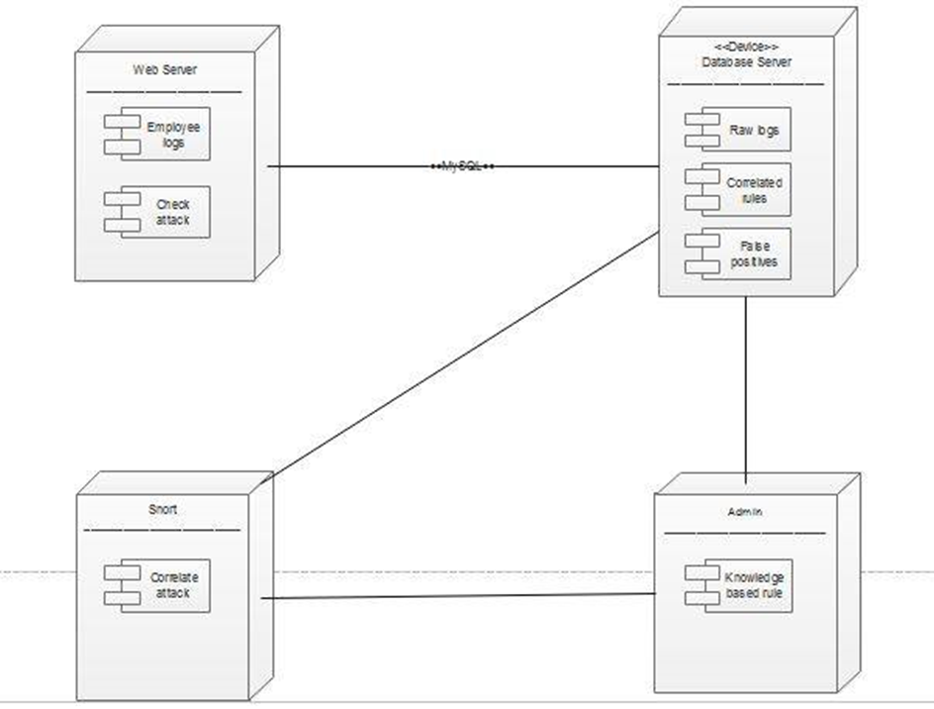
Deployment Diagram

